Slide 1

Project on Environment & Climate
Presented by: Sandra B
Course: MCA- General | Rig. No.: 2411022250001
PRIMARY SDG: SDG 13 – CLIMATE ACTION

Slide 2

The Climate Challenge
Extreme weather, rising carbon emissions, and a lack of public awareness about sustainable practices are pressing issues. Communities often lack simple tools for flood risk prediction, understanding their carbon footprint, or learning about climate change interactively.
How might AI help communities take timely and sustainable actions to reduce environmental impact?

Slide 3





AI-Powered Sustainability Tools
This project introduces three AI-based sustainability tools designed to address critical environmental challenges.
Flood Risk Prediction
Carbon Footprint Tool
Early warnings for communities.
Understand personal impact.
Climate Awareness Chatbot
Interactive education for all.

Slide 4

Flood Risk Prediction Assistant
This system predicts flood risk levels (Low, Moderate, High) based on environmental inputs like rainfall, river level, and soil moisture.
Key Inputs
It empowers communities and authorities to implement early precautionary measures, safeguarding lives and property.
Rainfall (mm)
River Level (m)
Soil Moisture (%)
Outputs
Flood Risk Level: Low, Moderate, High

Slide 5

Carbon Footprint Calculation Tool
This tool estimates an individual's monthly carbon footprint, helping users understand how daily activities contribute to climate change.
It encourages eco-friendly behavior by highlighting the impact of electricity usage, travel distance, and waste generation.
Factors Analyzed
Electricity Usage
Travel Distance
Waste Generation
Goal
Promote eco-conscious choices.

Slide 6
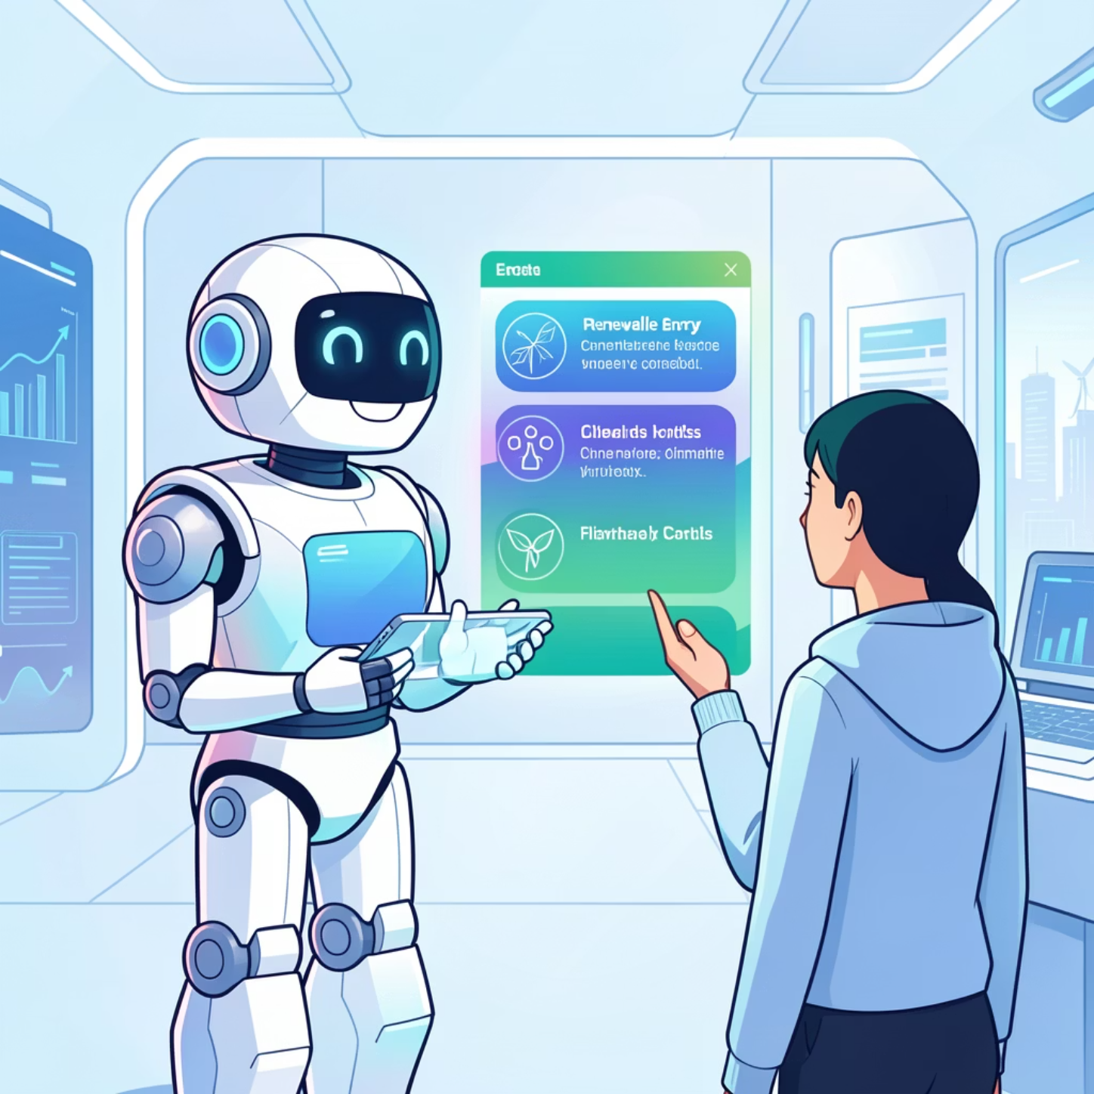


Climate Change Awareness Chatbot
A conversational AI chatbot designed to spread awareness about climate change in a simple and interactive manner.
Topics Covered
Climate Change Basics
Carbon Footprint
Renewable Energy
Sustainable Practices
Interactive Learning
Answers questions to foster understanding and engagement.

Slide 7

AI Elements & Tools
The project leverages logical AI workflows, focusing on practical application rather than complex machine learning, as per internship guidelines.
Programming Language
Python
AI Techniques
Rule-based prediction, Classification, Conversational AI
AI Concepts
Automation, Pattern-based prediction, Decision support
Technologies
Python functions, Conditional logic, Command-line processing

Slide 8


Prototype Demo: Flood Risk
Sample input and output for the Flood Risk Prediction Assistant.
Input Example
Output Example
Enter rainfall (mm): 245
Enter river level (m): 15
Enter soil moisture (%): 50
Flood Risk Prediction: MODERATE Flood Risk

Slide 9

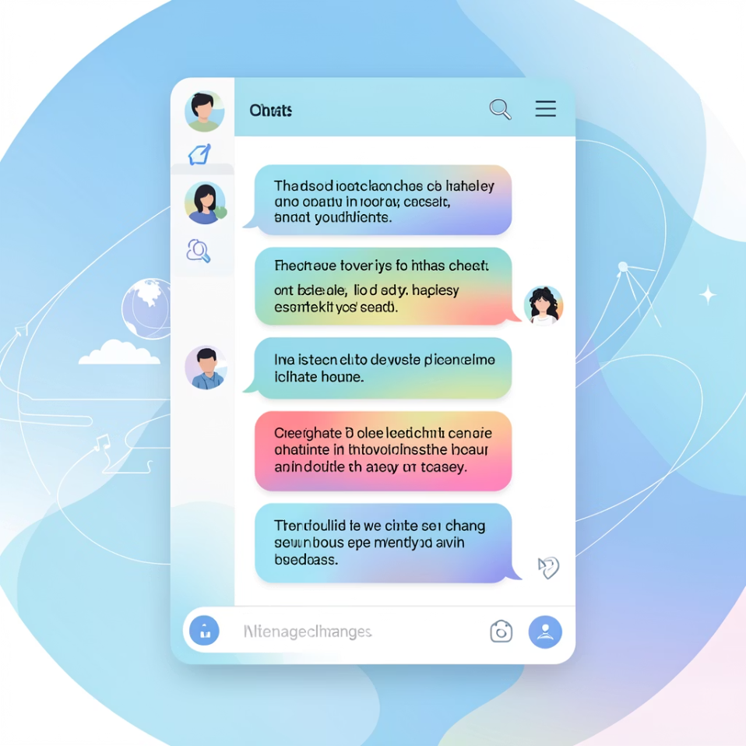
Prototype Demo: Carbon Footprint & Chatbot
Sample interactions with the Carbon Footprint Calculation Tool and Climate Awareness Chatbot.
Carbon Footprint
Chatbot Conversation
Electricity used (units/month): 34
Travel distance (km/month): 4
Waste generated (kg/month): 2
Estimated Monthly Carbon Footprint: 29.62 kg CO2
You: climate change
Bot: Climate change refers to long-term changes in temperature and weather patterns.
You: carbon footprint
Bot: Carbon footprint is the total greenhouse gas emissions caused by human activities.
You: how to reduce
Bot: You can reduce emissions by saving energy, using public transport, and reducing waste.
You: exit
Bot: Thank you for supporting climate action

Slide 10

Project Repository
Explore the Python-based command-line AI prototype on GitHub.
https://github.com/Sandrabindhu/1M1B-AI-for-Sustainability-Virtual-Internship-with-IBM-SkillsBuild-AICTE.git
These tools demonstrate how AI can responsibly predict risks, analyze environmental impact, and educate users, contributing to sustainability goals.

